Slide 1
Grand Saline High School Orientation

Slide 2
Graduation Requirements

Slide 3
Foundation High School Program
4 credits in English Language Arts
3 credits in Mathematics
3 credits in Science
3 credits in Social Studies
2 credits in Languages Other than English
1 credit in Fine Arts
1 credit in PE
5 credits in electives
(22 Total Credits)

Slide 4
Foundation High School Program with Endorsements
An endorsement requires the Foundation High School Program and:
• An additional advanced mathematics course = 4 total credits
• An additional advanced science course
= 4 total credits
• Coherent sequence of 4+ credits in a career path/concentrated area of study
(26 Credits Total)

Slide 5
Endorsement Areas
STEM – Science, Technology, Engineering & Mathematics
Business & Industry
Public Services
Arts & Humanities
Multi-Disciplinary

Slide 6
STEM Science, Technology, Engineering, Mathematics
GSHS PATHWAY OPTIONS:
Math
Algebra I , Geometry, Algebra II and 2 advanced math courses
DC College Algebra, Pre-Cal, Stats & Calculus

Slide 7
Business & Industry Endorsement
GSHS PATHWAY OPTIONS:
Agribusiness
Animal Science
Business Management
Computer Programming
Digital Art/Photography
Finance
Horticulture
Metal Fabrication
Wildlife

Slide 8
Public Services Endorsement
GSHS PATHWAY OPTIONS:
Health Science
Medical Certifications - Phlebotomy, Pharmacy Technician, Medical Assistant, EKG, Medical Health Records, Billing & Coding and Patient Care Technician, EMT
Public Safety
Firefighter Certification
Education

Slide 9
Arts and Humanities Endorsement
GSHS PATHWAY OPTIONS:
Social Studies
5 credits
Spanish
4 credits of the same language
Fine Arts – Band, Art & Theater
4 credits in the same area OR
2 credits in one area and 2 credits in a different fine arts area

Slide 10
Multidisciplinary Studies Endorsement
4 X 4
4 English credits
4 Math credits
4 Science credits
4 Social Studies credits
Dual Credit
Four DC courses for 4 credits in English, Math, Science, Social Studies, Language other than English or Fine Arts
Career & Technical Education (CTE)
Four advanced courses that prepare students to enter the workforce or postsecondary education

Slide 11
What else do I need to know?
Distinguished Achievement
Successful completion of all of the following:
•A total of four (4) credits in mathematics which must include Algebra II
•A total of four (4) credits in science
•The curriculum requirements for at least one (1) endorsement
*Students must graduate at the Distinguished Level to qualify for top 10% automatic admissions to Texas public colleges and universities.

Slide 12
What else do I need to know?
Performance Acknowledgements
Successfully completing one of the following:
• 12 hours in dual credit courses with a grade of A or B
• achieve National Merit/Commended Scholar on PSAT, SAT or the ACT
• earning an industry-based license or certification
Credit Requirements - must be earned to advance grades
STAAR EOC Testing
English 1, Algebra 1, Biology
English 2, US History

Slide 13
What else do I need to know?
Attendance
In order to receive credit or a final grade for a class, a student is required to attend class 90 percent of the days class is offered regardless of whether the student's absences are excused [see FEA] or unexcused. Atty. Gen. Op. JC-0398 (2001)

Slide 14
How Will Students Select an Endorsement?
Each 8th grade student will:
Has completed an educational plan of study (4 year plan) based on their interests
the educational plan of study designates the endorsement the student will pursue
students may earn more than one endorsement

Slide 15
College Opportunities
Dual Credit
Enrolled in a college course while in high school
Receives credit for high school and college at the same time
Courses available to all high school students meeting TSI testing criteria
TJC Promise
Student’s in the TJC tax district have the opportunity to earn up to two years of a college education at TJC.
Covers tuition and fees for up to two years through a combination of federal grants, TJC Scholarships, and the TJC Promise
Creates an environment that will promote and encourage a college-going culture among families and high schools.

Slide 16
Dual Credit
Tyler Junior College
Currently offer 84 hours of college courses
Core Course Completion
Associate Degree in General Studies
Dual Credit Orientation Required
Kilgore College
Firefighting & EMT
Fire Academy Orientation Required
Begins 11th grade year
Taught on campus

Slide 17
TJC Promise
Students pledge they understand The Promise criteria and will work to meet the criteria – Fall of 9th grade
of 9th grade
Academic Achievement – 80 + cumulative GPA
Persistence (Attendance Requirement)
5 or fewer unexcused absences spring of 9th grade year
10 or fewer unexcused absences 10th – 12th grades
Advance each year
Enroll in TJC directly after graduating high school
Community Service
25+ hours by April of their graduating year

Slide 18
Other Opportunities
Mineola ISD CTE Programs
Begins 11th grade year
AWS, OSHA, EPA & more certification options
Transportation provided
Program Options
Welding
HVAC
Automotive (coming soon)

Slide 19
What else do I need to know?
GPA (Grade Point Average) & Rank
Starts 9th grade
Determines college eligibility
Calculated at the end of each semester
Automatic College Acceptance
Top 10%
Academic Admit

Slide 20
What else do I need to know?
Become Involved
Extra-curricular activities
Community service
Leadership roles
Summer academic programs
College and Career Readiness
Maintain good grades
College entrance exams (SAT/ACT)

Slide 21
What else do I need to know?
Prepare document organizer
Academic records
Activities
Awards
Google Classroom – Class of 2029
Remind – Class of 2029
Text this message: @gshs2029 to 81010

Slide 22
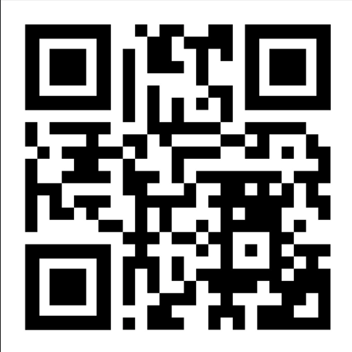
Student/Parent Consent Form Associate Degree Checklist & Course Options
Dual Credit Handbook

Slide 23
Steps to Dual Credit Program
Apply to Tyler Junior College as a dual credit student
Submit Student/Parent Consent Form
Meet Texas Success Initiative (TSI) Testing Requirements
Complete TJC Registration Form each semester

Slide 24
Course Options
Academic Courses
Core Curriculum pg. 4
40 transferable hours
CTE Courses
No cost or testing requirement
Flexible Pathways
Associate Degree
Pros/Cons
Individualized Plans
Athletes
Area of interest
Course availability & changes
Recommended timeline

Slide 25
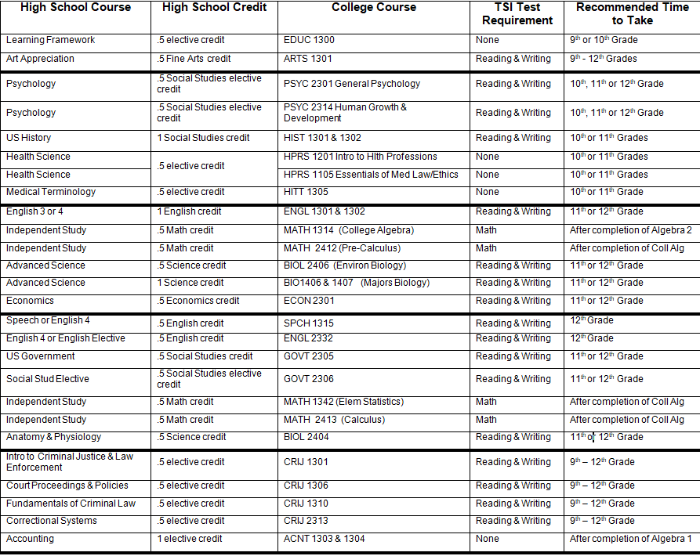

Slide 26
Dual Credit Opportunities
Page 2 of the DC Handbook
GSISD pays $525 per student each semester
All textbooks are provided by GSISD

Slide 27
Responsibilities
Maturity
Attendance
Initiative
Independent Learner
Academic Integrity
How is College Different from High School (Adapted from SMU, A-LEC Center) pg. 6

Slide 28
Responsibilities
Grades (pgs. 2, 4 & 5)
GPA
Failures & Drops (pg. 2)
Fees
Long term academic consequences
2 failing grades and/or drops
Academic Standing & Probation
Drop Request Forms
GSHS (pg. 9)
TJC

Slide 29
Texas Success Initiative Assessment
Page 1 of DC Handbook
Placement test for college courses
Reading & Writing Section
Math Section
GSHS – Testing Site
Initial Testing – Free
Retesting fee not to exceed $5

Slide 30
Forms
Student/Parent Agreement (pg. 10)
Review
Sign & Return
Probation Contract (pg. 8)
Withdrawal/Drop Request (pg.9)
School Partnerships Student/Parent Consent Form (TJC Form)
Review
Sign & Return

Slide 31
Transferring Courses
University Discretion vs State Requirement
Degree Plan Requirements
Texas Common Course Numbering System
www.tccns.org

Slide 32
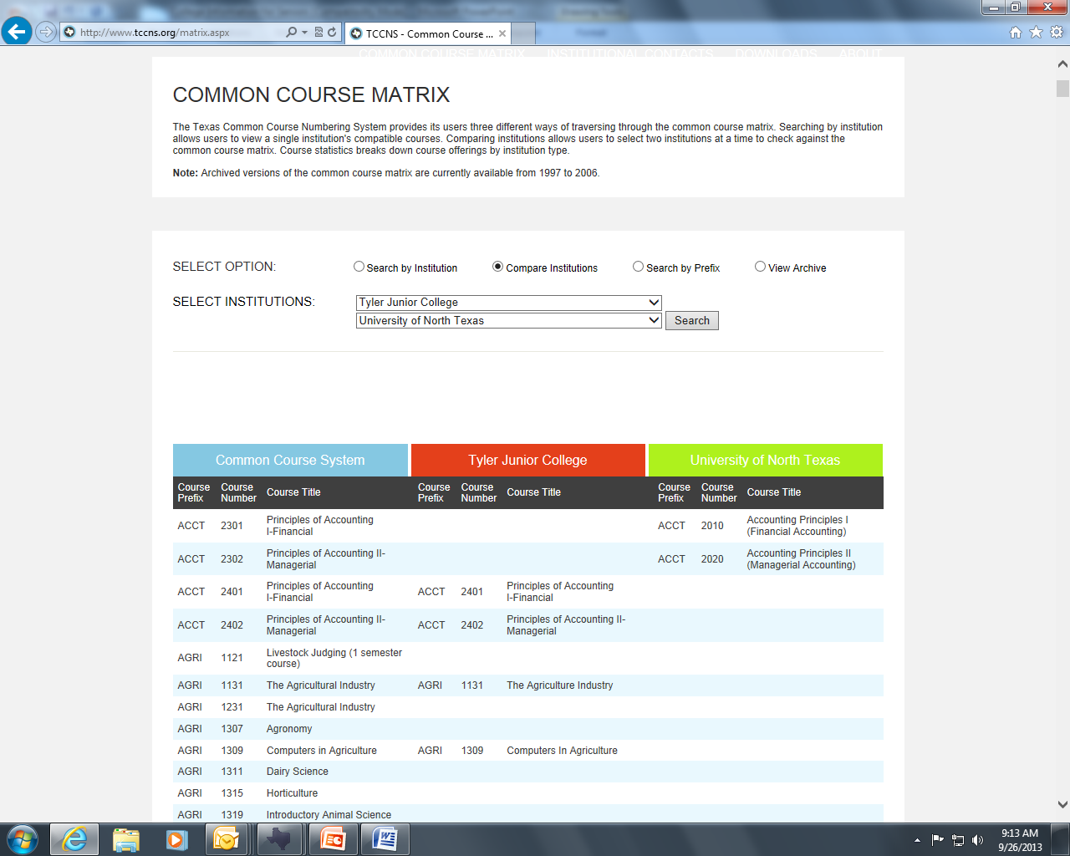

Slide 33
What’s Next?
Student/Parent Agreement Form
TJC Student/Parent Consent Form
Apply to TJC w/ HS Counseling Department
Register w/ HS Counseling Department

Slide 34
For questions, please contact the school office.
Grand Saline Middle School
903-962-7537
Grand Saline High School
903-962-7533
Caroline LaPrade, GSMS Counselor
claprade@grandsalineisd.net
Robin Goff, GSHS Counselor
rgoff@grandsalineisd.net
Stephanie Key, GSHS Student Support Coordinator
skey@grandsalineisd.net

